Slide 1
At the end of that life Crossroads
To deliver a game prototype with storytelling driving the main gameplay.
Notes:
My team and I will deliver a game prototype with the story driving the main gameplay.

Slide 2
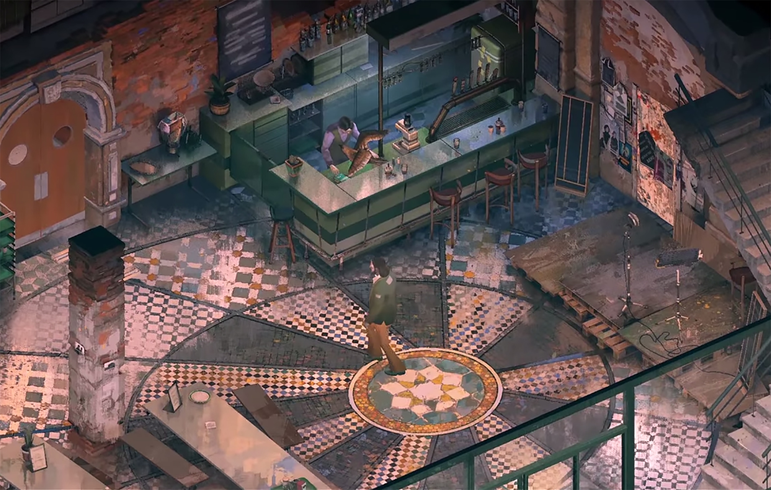
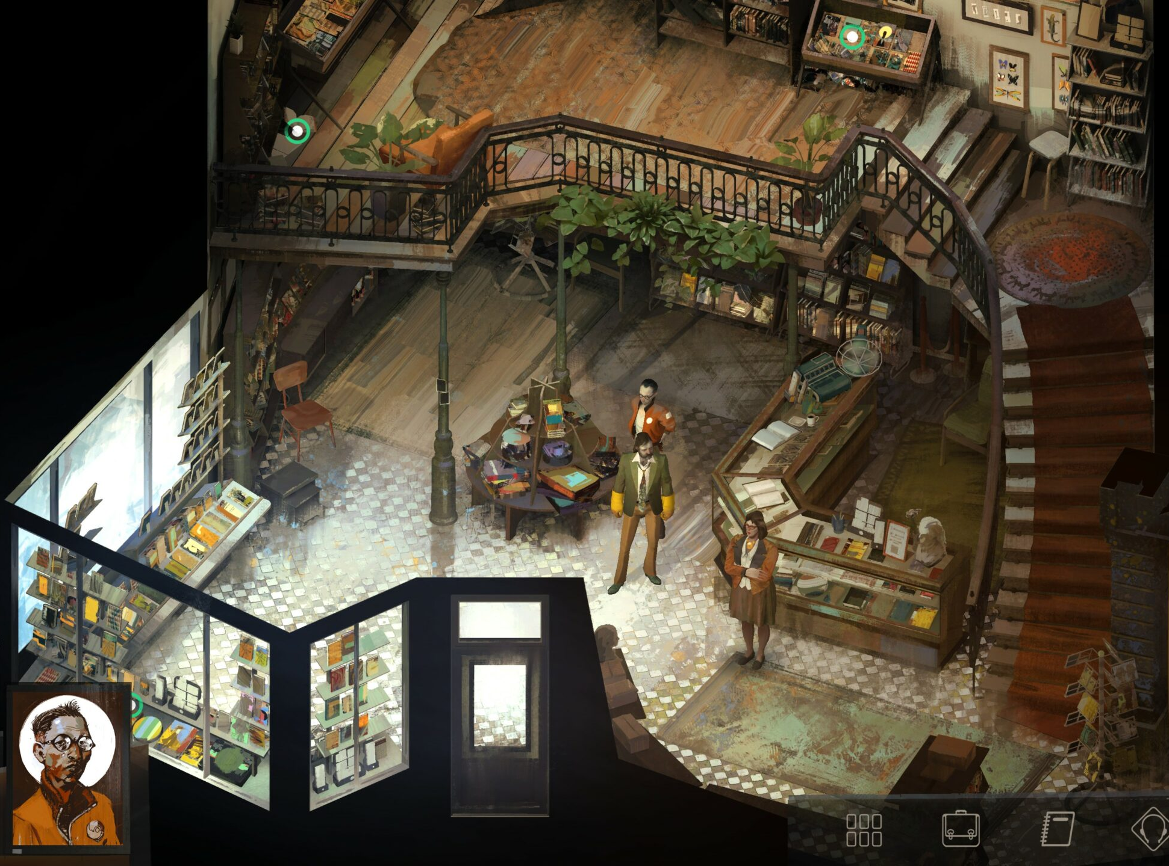
Art-style/ Gameplay will be similar to
Disco Elysium and What remains of Edith Finch
Notes:
The game will have a top down, isometric view which is like to Disco Elysium. Since we are trying to tell a story, the game mechanics will be based on the story and it will be mostly linear. This has been inspired from “What remains of Edith Finch” which tells us the story of the deaths in a family. The gameplay is very narrative driven and is unlike any having effortless, easy and yet unique puzzles.
I’ve always liked prototyping games. Since this is my hons year, I wanted to work on something more challenging and this project is a bit more ambitious that the other games I’ve worked on. It will be helpful to have it on my portfolio as I want to start my own Studio. This will showcase my design and development skills as well as being the team lead will show my project management.

